Slide 1

Hotel Management System
STUDENT 1 - VED TUSHARBHAI PATEL (RA2211003010609)
STUDENT 2 – SHREYAN SARKAR (RA2211003010771)
A comprehensive software solution for efficient hotel operations. Integrates modern technologies to streamline bookings, room management, and customer service.

Slide 2


Frontend Design
1
React
Core library for building user interfaces and single-page applications.
2
React Router
Enables dynamic routing for seamless navigation between views.
3
Axios
HTTP client for making asynchronous requests to the backend.

Slide 3

Frontend Technologies
1
Bootstrap
2
JavaScript (ES6+)
3
CSS Preprocessors
CSS framework for responsive design across devices.
Modern JavaScript features for enhanced code readability and efficiency.
SASS or LESS for advanced styling capabilities.

Slide 4

Backend Design
Spring Boot
1
Core framework for Java application development with auto-configuration features.
2
Spring Data JPA
Simplifies database operations with repository abstraction layer.
MySQL
3
Relational database for storing hotel data securely.

Slide 5

Backend Technologies
Spring Security
1
Ensures secure authentication and authorization for user data protection.
2
Hibernate
ORM tool for simplified database interactions and object mapping.
Maven
3
Manages dependencies and automates the build process.

Slide 6

Functional Requirements
User Management
Room Management
Booking System
Registration, authentication, and role-based access for users and admins.
Add, edit, and delete room details, manage availability and pricing.
Search, reserve, modify, and cancel room bookings with notifications.

Slide 7
Non-Functional Requirements
Performance
Security
Usability
Handle multiple users simultaneously with minimal response times.
Encrypt sensitive data and implement role-based access controls.
Intuitive interface compatible across devices. Scalable for future growth.

Slide 8
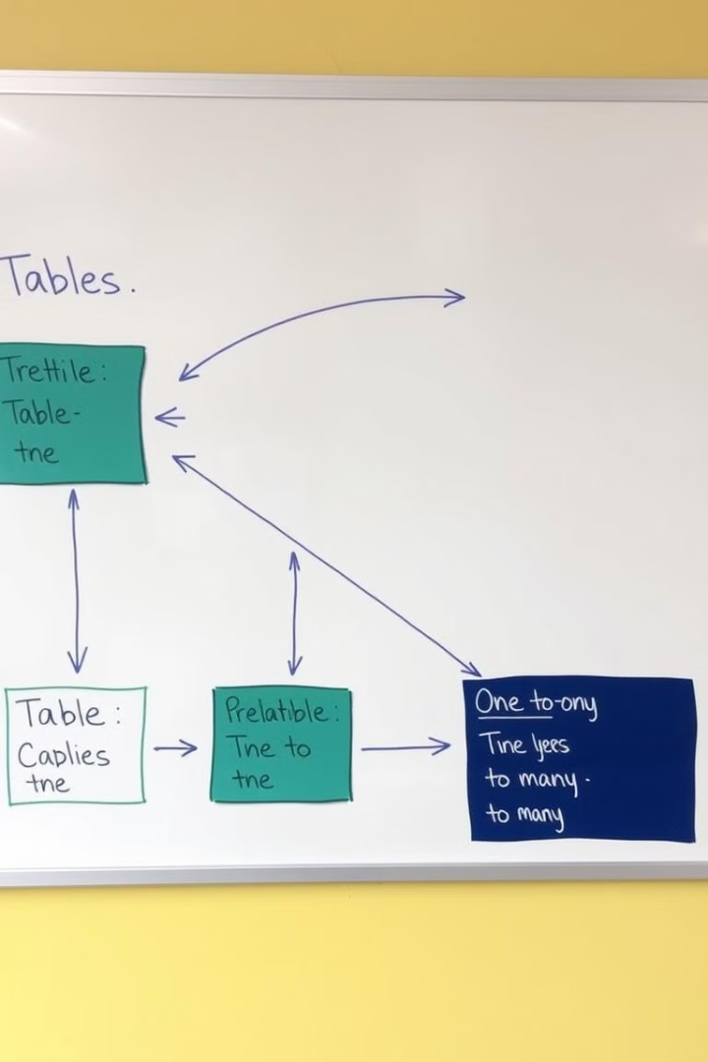
Database Design
Entity
Key Attributes
User
user_id, username, password, email, role
Room
room_id, room_number, type, availability, price
Booking
booking_id, user_id, room_id, dates, status

Slide 9
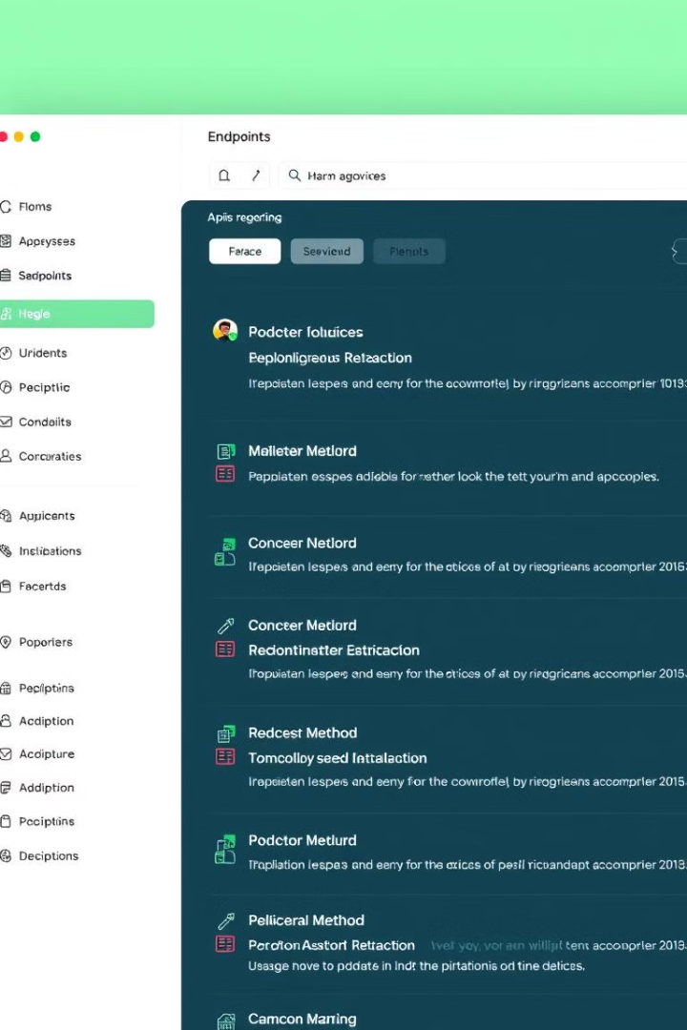



API Design
RESTful Architecture
Endpoints for bookings, rooms, and user management.
Authentication
JWT implementation for secure user authentication.
CRUD Operations
HTTP methods for creating, reading, updating, and deleting resources.

Slide 10
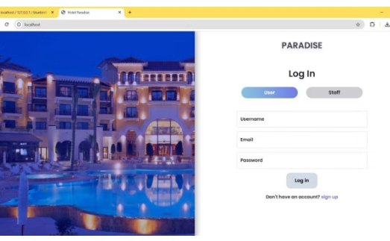
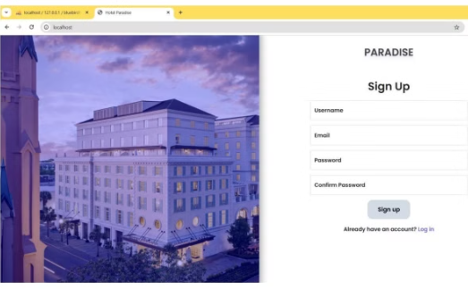
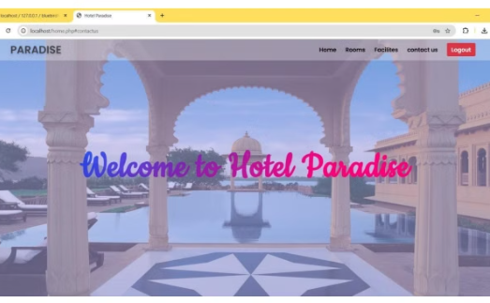
Project Outcomes
User Interface
Admin Dashboard
Mobile Responsiveness
Intuitive booking system for easy room reservations.
Comprehensive management tools for hotel staff.
Seamless experience across devices for user convenience.

